Slide 1
Storms

Slide 2
I Can…
Define “storm”
Identify the different types of storms
Explain how different types of storms form
Describe how to stay safe in a storm

Slide 3
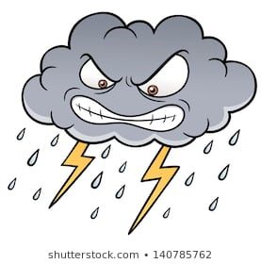
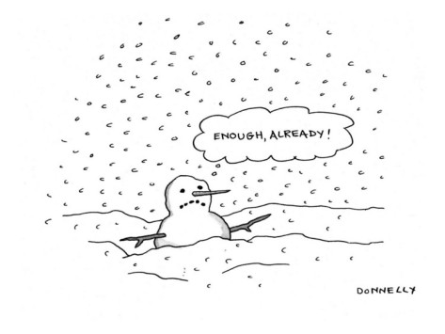
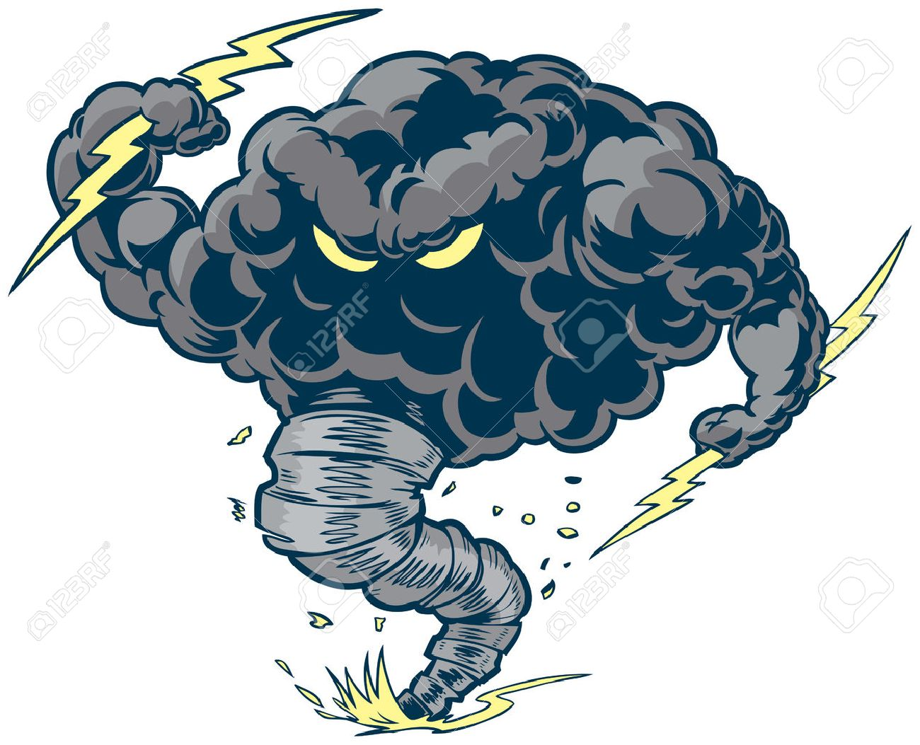
A violent disturbance in the atmosphere
Thunderstorm
Winter Storm
Lightning & Thunder
Flash Flooding
Hurricanes
Tornadoes
Caused changes in AIR PRESSURE
STORM

Slide 4
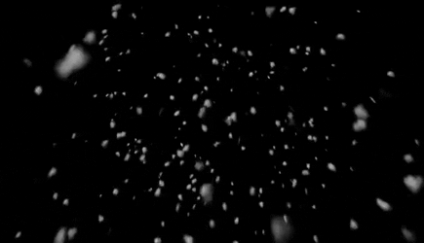
Winter Storms
Often occur in Northern United States
If the air is colder than 0ºC (32ºF) all the way to ground, the precipitation falls as snow.
Heavy Snow Dangers
Block Roads
Trap People
Damage Crops
Burst Pipes

Slide 5
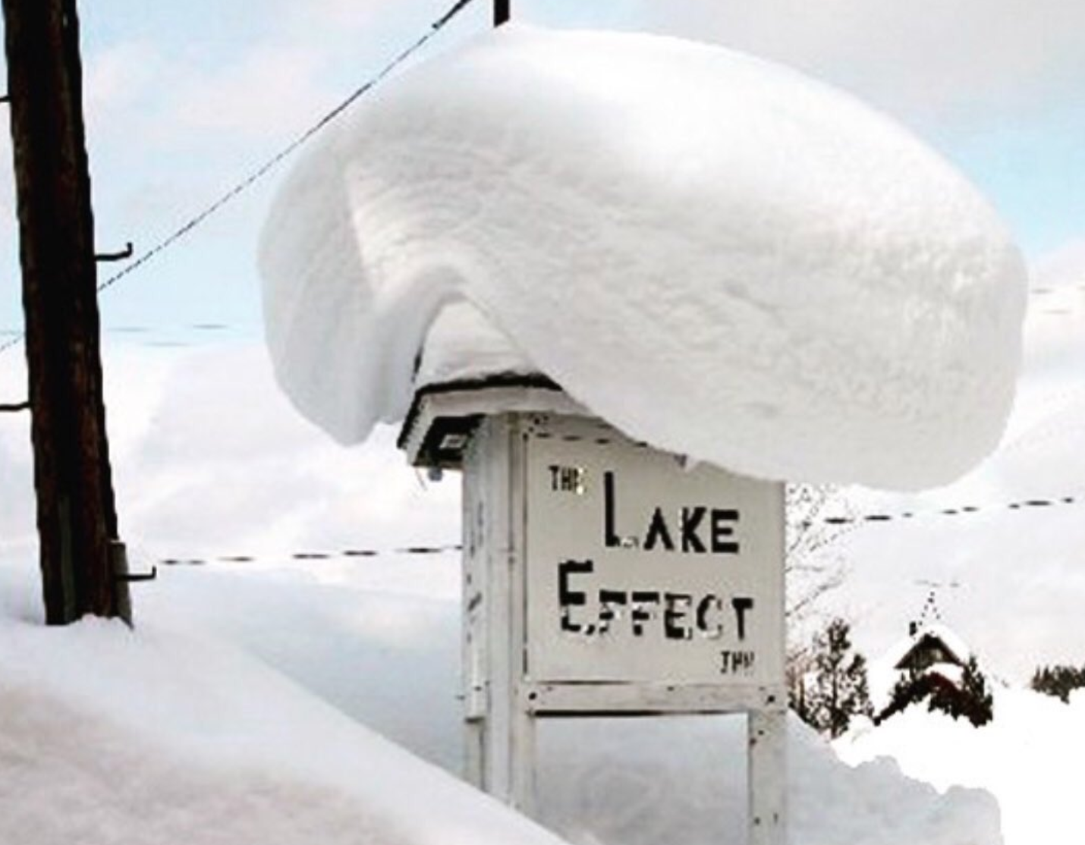
The Lake Effect
In the Fall & Winter, the land near water cools much faster than the water
When dry air moves across the lake it picks up water vapor & heat
When the air mass reaches the other side of the lake it cools down again
The water vapor that was collected then falls as snow
Happens near cities like Buffalo & Rochester, New York
Near Lake Erie

Slide 6
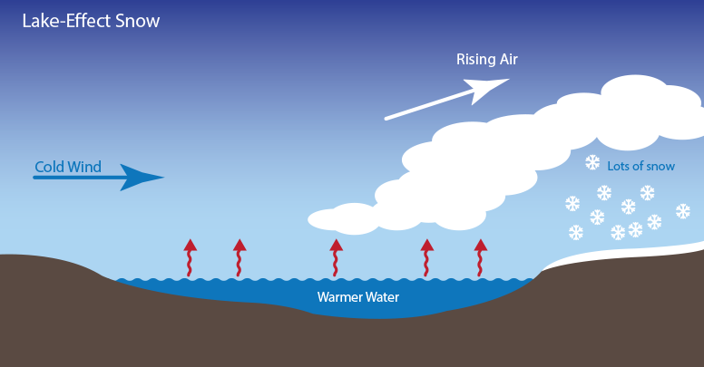

Slide 7
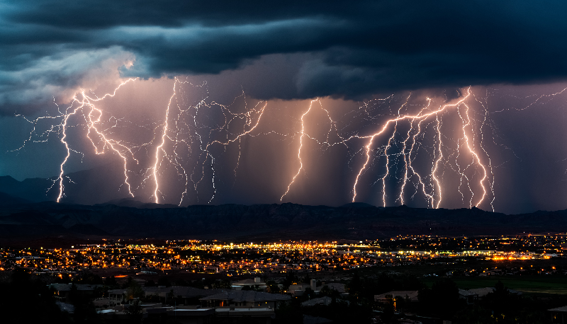
Thunderstorms
A small storm often accompanied by heavy rain & frequent thunder & lightning
Heavy Rain
Lightning
Cumulonimbus Clouds

Slide 8
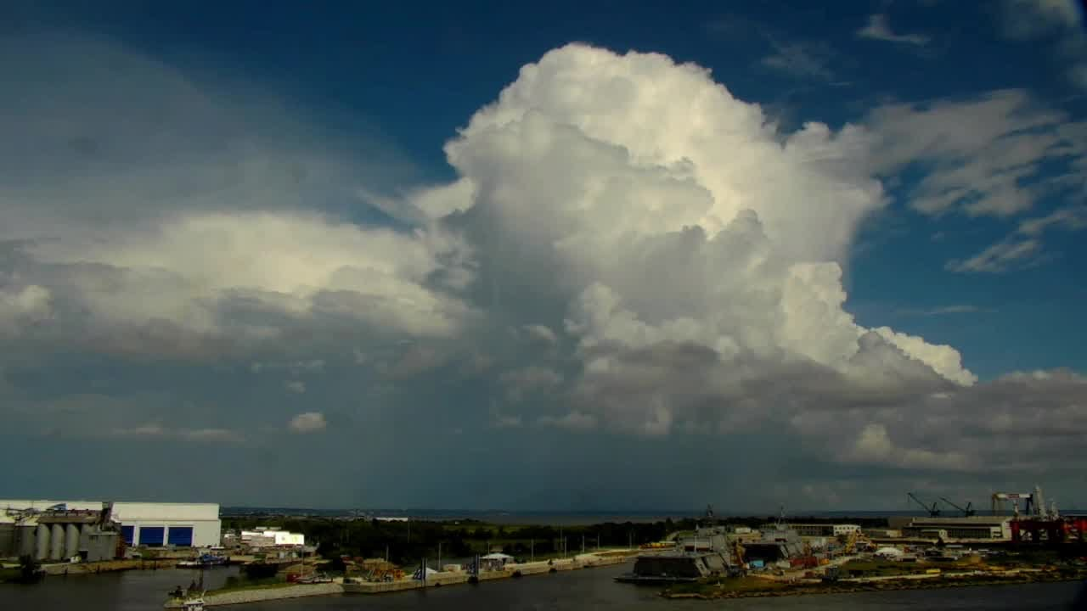
Thunderstorms
Form in cumulonimbus clouds
Also called thunder head clouds
Form when hot, humid air is forced upward by a cold front
Sometimes hail falls with the rain
Within the cloud are strong upward and downward winds
Mostly form in Spring & Summer months or in the western plains

Slide 9
Lightning & Thunder
Lightning- sudden spark of electrical discharge
Charges jump between parts of a cloud or between the cloud & ground
Lightning can heat the air around it (hotter than the sun’s surface)
Rapidly heated air expands explosively
Thunder – the sound of the explosively expanding air
We hear it 2nd because light travels faster than sound

Slide 10
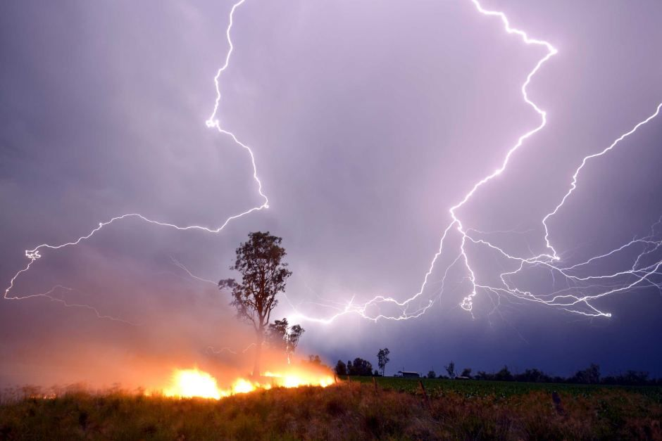
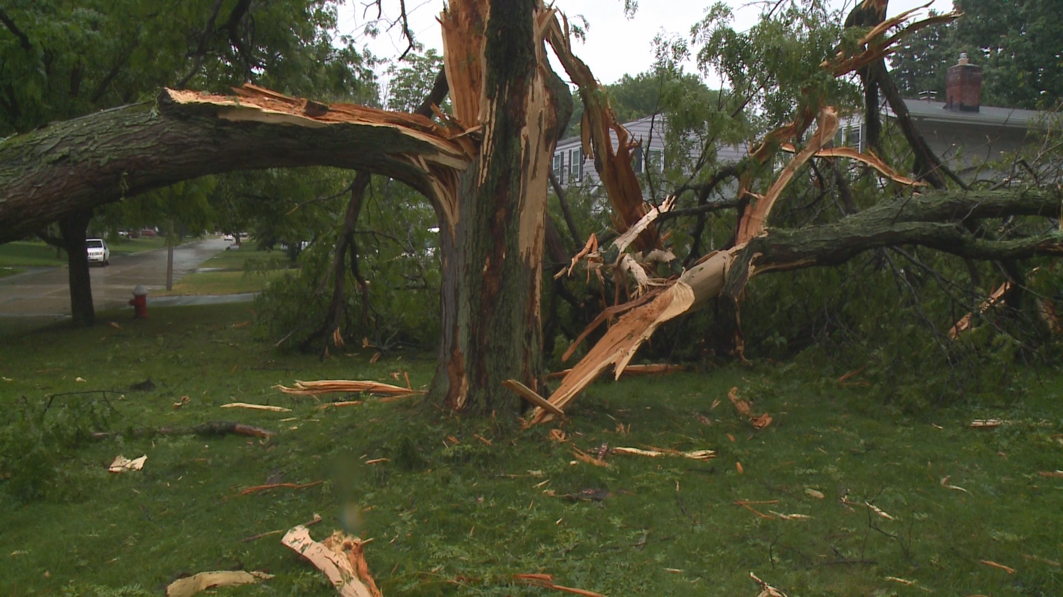
Thunderstorm Damage
Can flood areas
Shatter tree trunks / create forest fires
Lightning can cause serious burns & death

Slide 11
Floods
When rain water overflows rivers, lakes or streams
Ground can become oversaturated as well
Flash floods are sudden & violent

Slide 12
Hurricanes
Form over warm ocean water and begins as a low pressure area
Warm air rises and as more air is pushed up the cooler air is pushed out causing a spiral
Winds spiral inward toward the low pressure which increases wind speed
It grows into a tropical storm before becoming a hurricane
Hurricane- Tropical cyclone with winds over 74 mph
Also called typhoons & cyclones

Slide 13
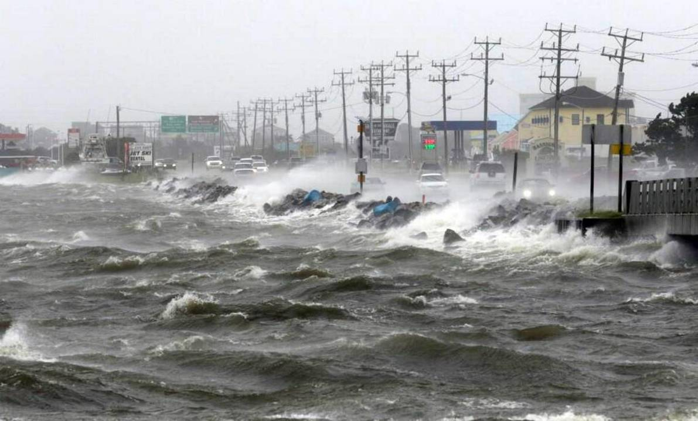
Hurricane Movement & Damage
Can last a week or more
Weakens when it passes over land
Hits land with high winds and heavy precipitation
Storm Surge- a dome of water the sweeps across the coast where a hurricane lands
Wash away beaches
Destroy buildings

Slide 14
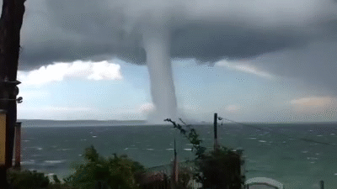
Tornadoes
Tornado- rapidly spinning column of air that reaches down from a thunderstorm to touch Earth’s surface
Called a waterspout if it forms over a body of water
Typically short-lived
FORMATION
Form during severe weather
Cumulonimbus clouds
Warm air flows upward & begins to rotate

Slide 15
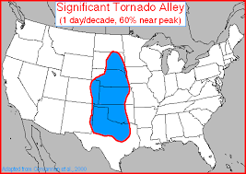
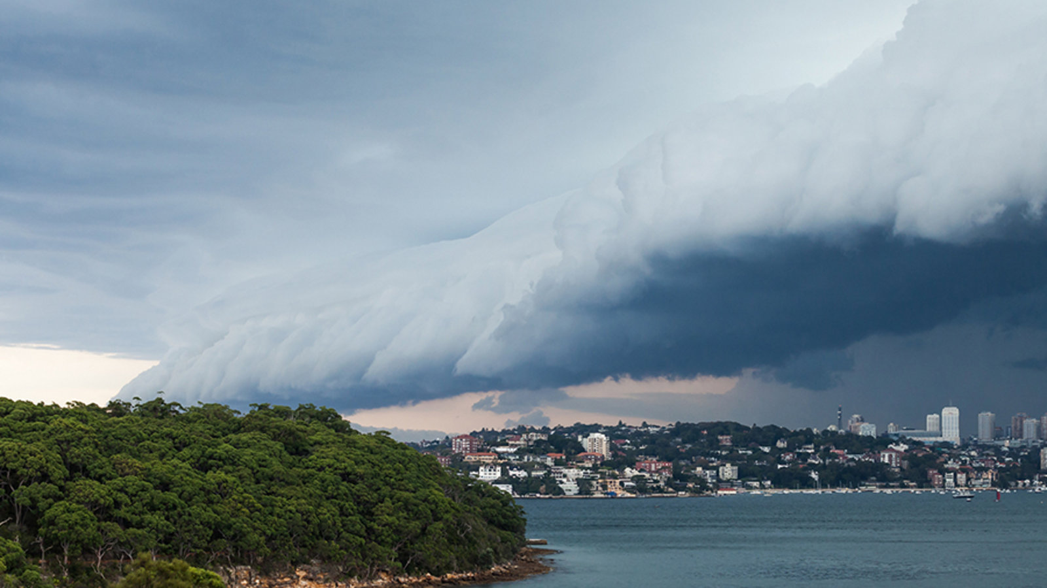
Tornado Alley
Great plains
Warm, humid air moves north from the Gulf & meets dry cold air from Canada
Forms a line of storms
Squall line

Slide 16
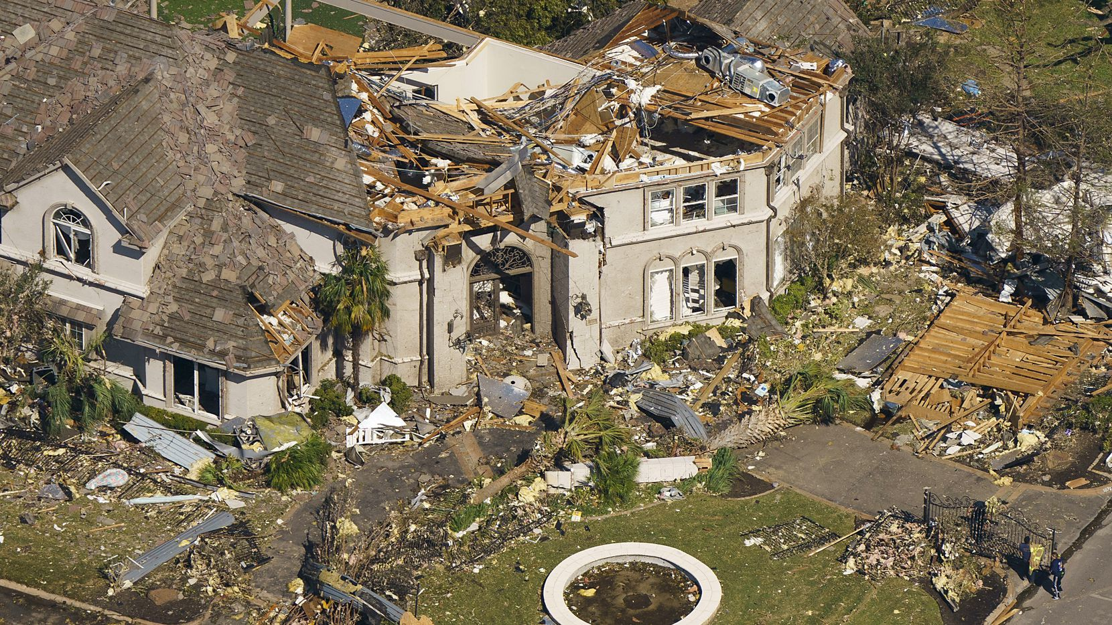
Tornado Damage
Damage comes from strong winds & flying debris
Low pressure sucks objects into the funnel
Can move extremely large objects & drop them off miles away
Measured on the ENHANCED FUJITA SCALE
Light damage = EF0 (branches broken off trees)
Extreme damage = EF5 (Houses carried away)

Slide 17
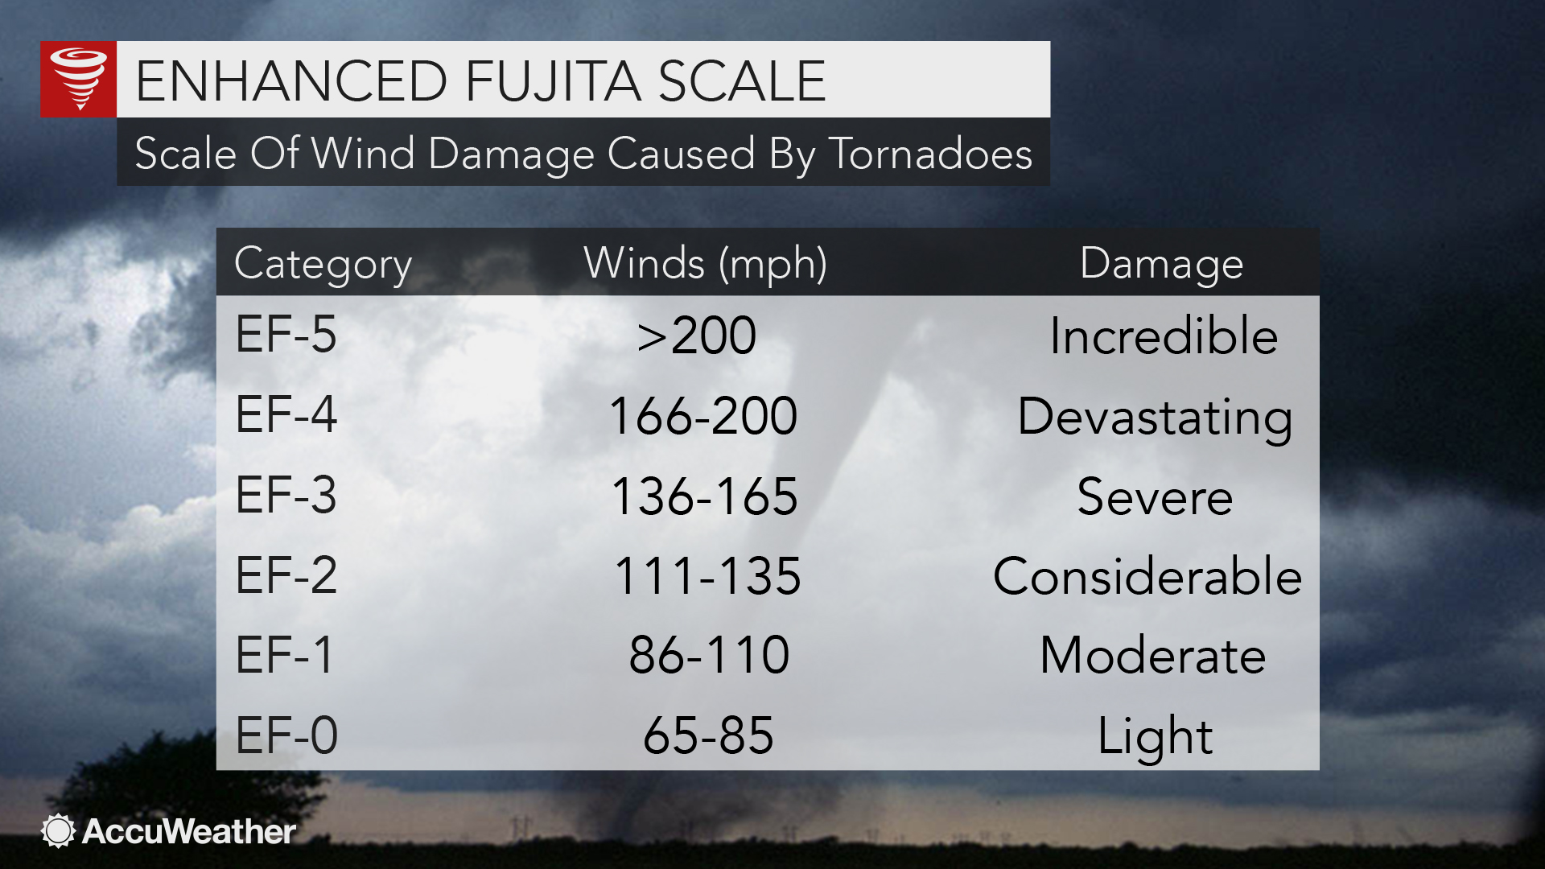
Enhanced Fujita Scale

