Slide 1
Predicting the Weather

Slide 2
Learning Targets
I can use observations to predict the weather
I can use weather maps to create a weather forecast

Slide 3
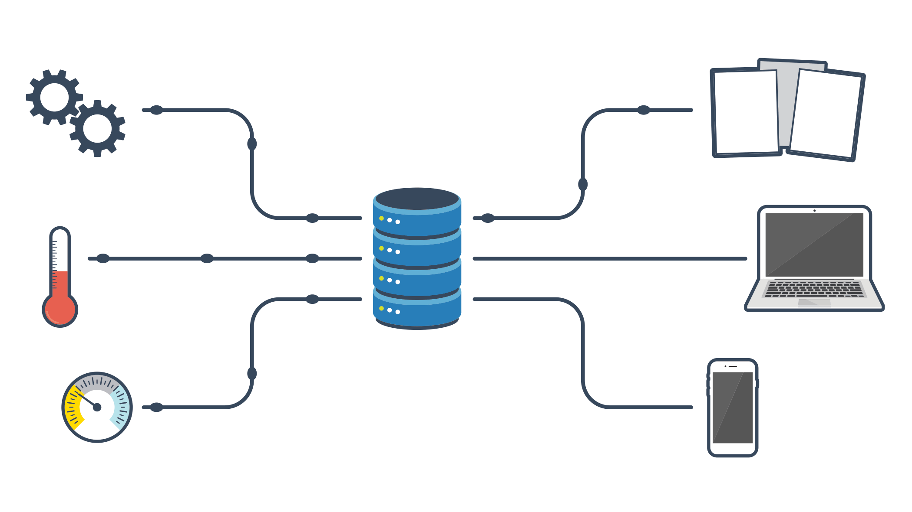
How Do You Predict the Weather
1st Step: COLLECT DATA
To do this:
Use Observation
Use Instruments

Slide 4
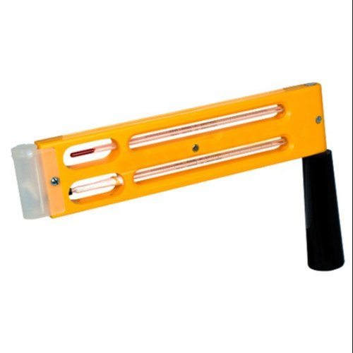
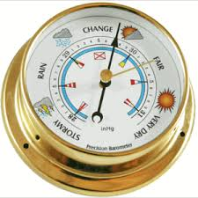
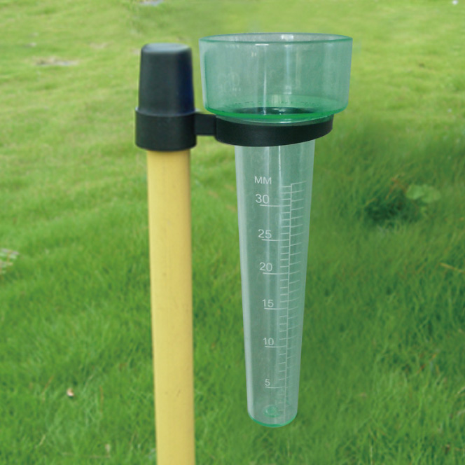
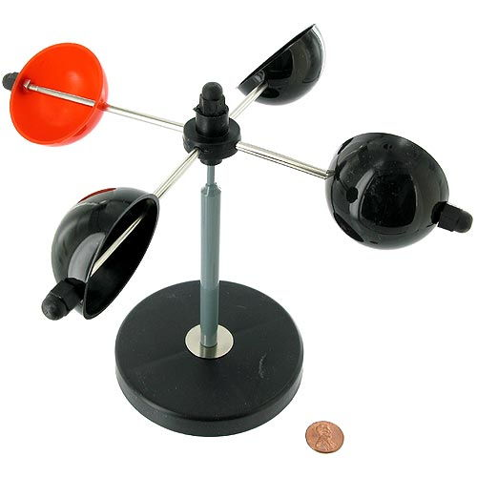
Weather Instruments
Air Pressure:
Barometer
Wind Speed:
Anemometer
Humidity:
Psychrometer
Temperature:
Thermometer
Precipitation:
Rain Gauge

Slide 5
PREDICT……
What type of weather can you expect if a barometer shows that air pressure is falling?
Low-pressure system that is possibly bringing rain or snow

Slide 6
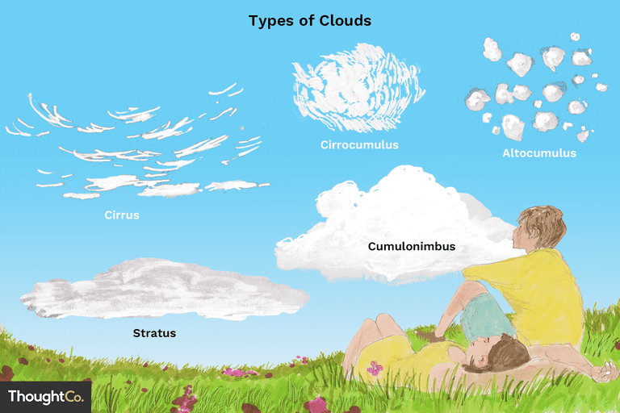
Making Simple Observations
Cumulus clouds often form on warm days
If the grow larger & taller they can turn into cumulonimbus
These clouds bring thunderstorms
Thin cirrus clouds in sky tell us a warm front may be approaching

Slide 7
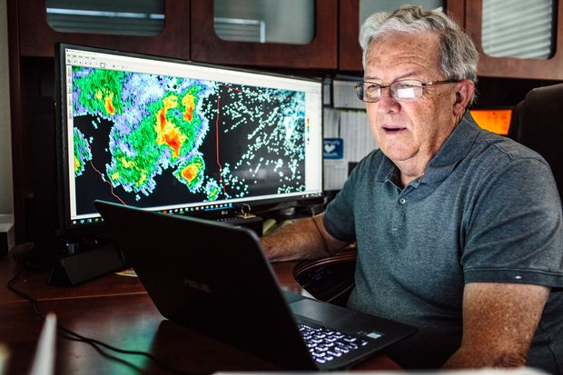
Meteorologist
Scientist who studies & tries to predict the weather
Weather
Storm Chaser
Not always seen on TV

Slide 8
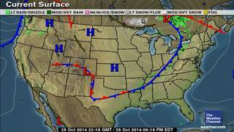
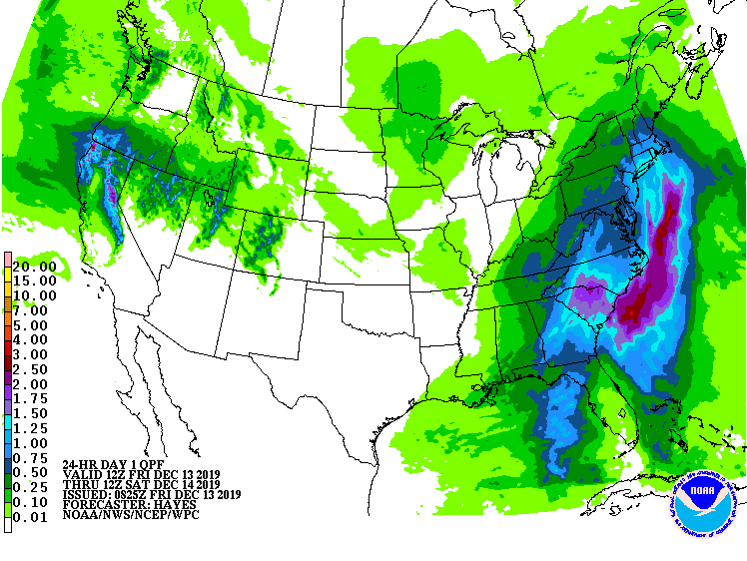
Interpreting Complex Data
Use Maps
Use Charts
Use Computers
Use Weather Balloons
Use Satellites
Use Radar
Use Instruments

Slide 9
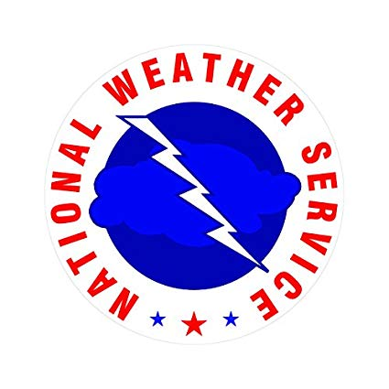
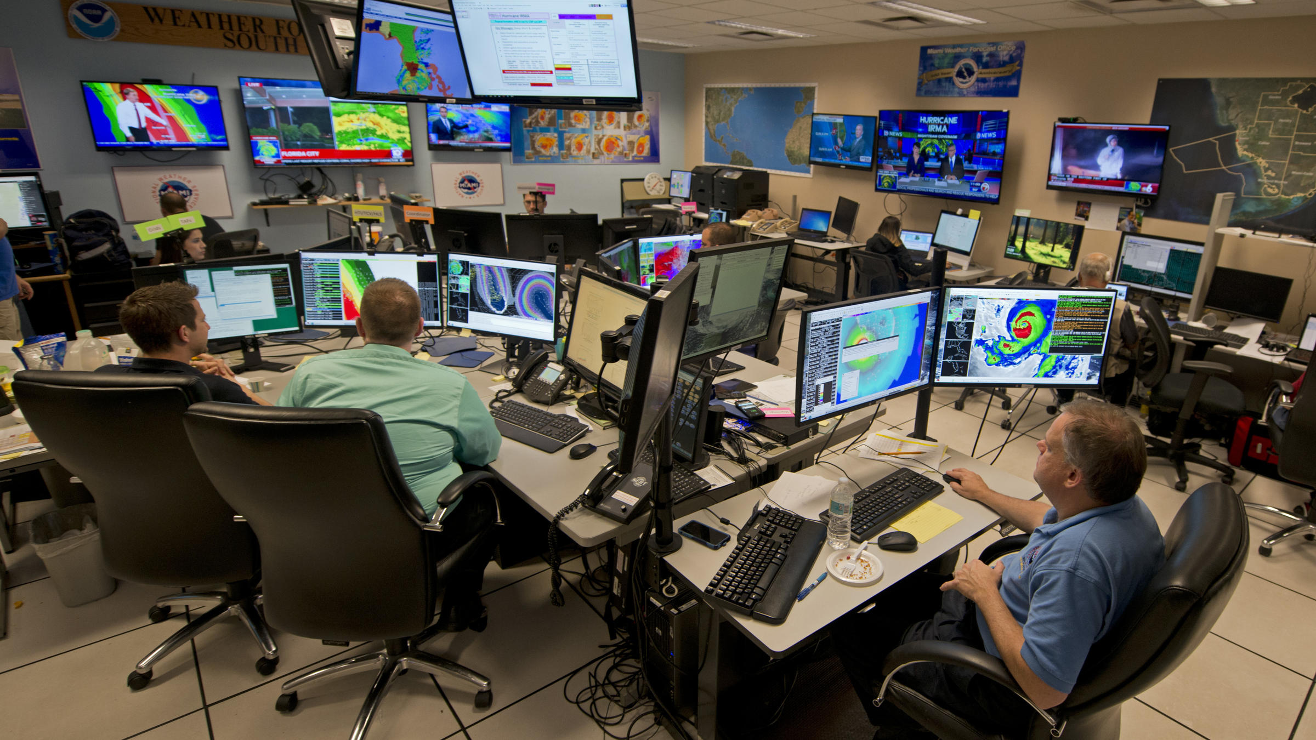
National Weather Service
Weather reporters get their information from here.

Slide 10
Using Technology
Due to enhancement of technology, short-range forecasts are now more reliable
Weather stations, satellites, balloons, and computer forecasts have all increased accuracy of forecasts

Slide 11
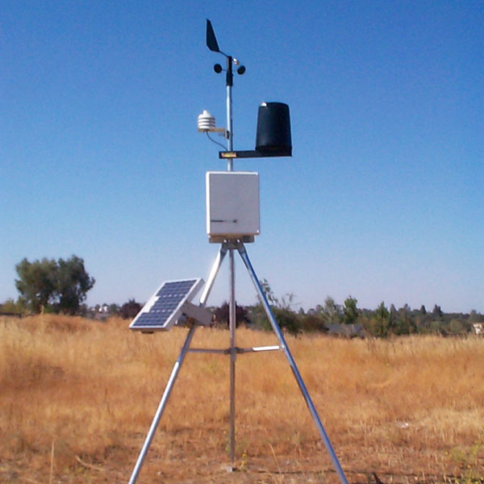
Weather Stations
Localized station that uses surface instruments to collect data
Wind Speed
Humidity
Rain fall
Wind direction

Slide 12
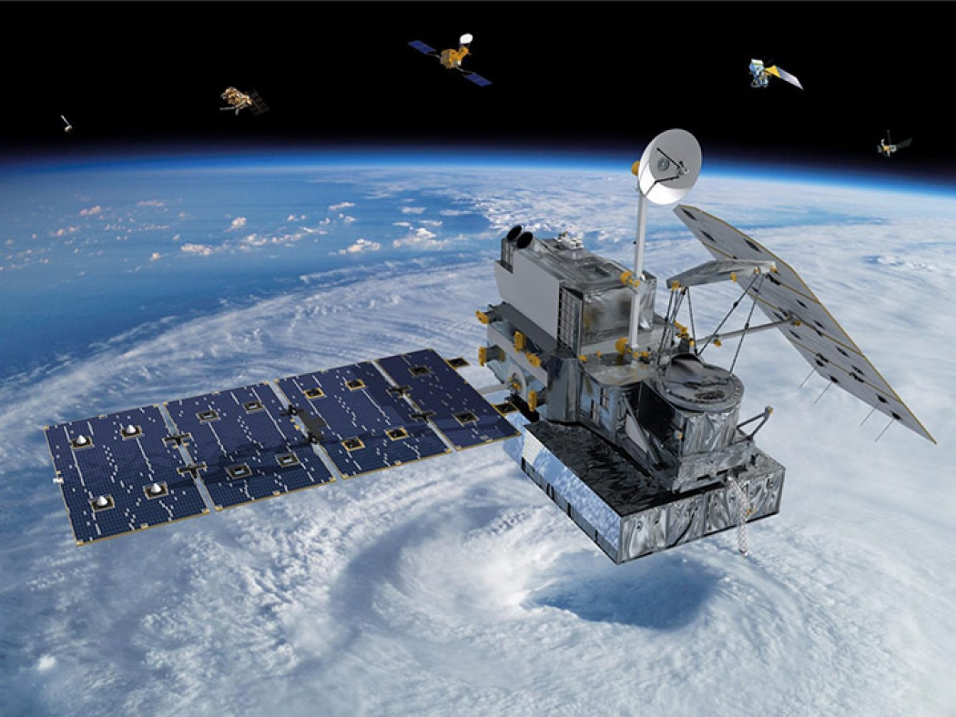
Weather Satellites
Orbit Earth in the Exosphere
Cameras take pics of the surface
Also collect data on temperature, solar radiation, & wind

Slide 13
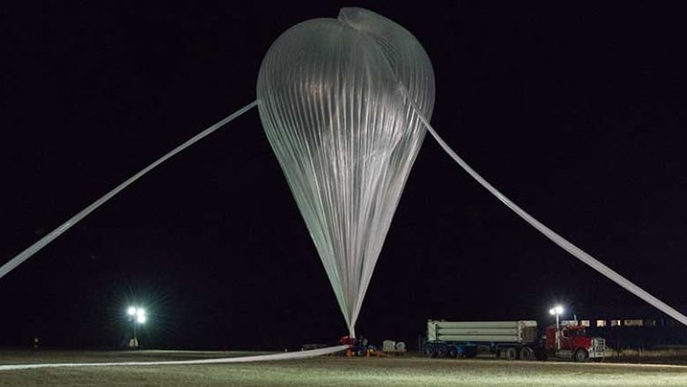
Weather Balloons
Device used to carry instruments into higher altitudes to collect data
Usually upper troposphere / lower stratosphere
Measure temp, humidity, air pressure

Slide 14
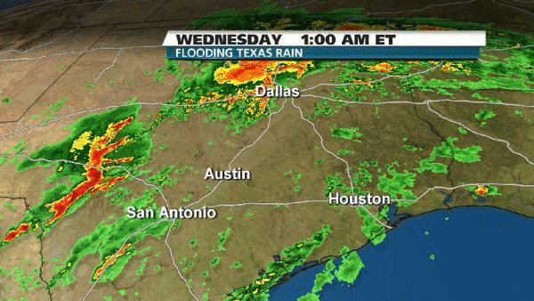
Computer Forecasts
Process data quickly to create weather predictions

Slide 15
What Can You Learn from Weather Maps?
Different types of weather maps tell people different things

Slide 16
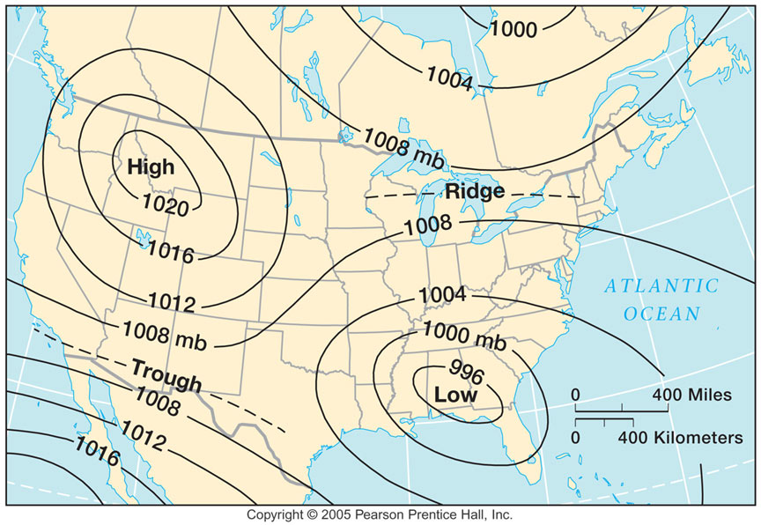
Weather Service Maps
Some maps show curved lines that connect places with similar conditions.
Isobar- lines joining places on the map with the same air pressure.
Iso means EQUAL
Bar means weight
Isotherms- lines joining places with the same temperature
Therm usually refers to temperature or heat

Slide 17
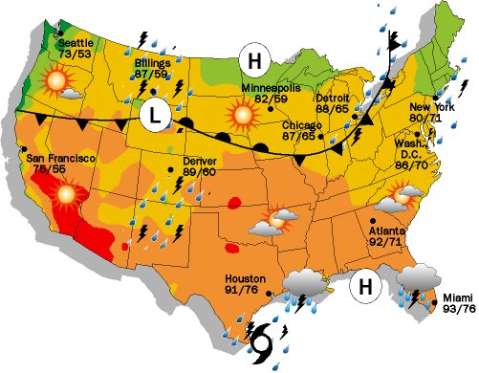
Newspaper Weather Maps
Simplified versions
Show high & low pressure Areas
Show precipitation
Show temperature

Slide 18
Weather Forecast Limitations
Butterfly Effect!
1 small change today could mean a large change in a month

Slide 19
