Slide 1
Heat Transfer Picture Quiz

Slide 2
Radiation, Conduction, or Convection

Slide 3
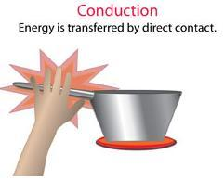
Radiation, Conduction, or Convection

Slide 4
Radiation, Conduction, or Convection

Slide 5
Radiation, Conduction, or Convection

Slide 6
Radiation, Conduction, or Convection

Slide 7
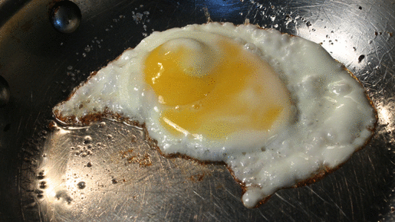
Radiation, Conduction, or Convection

Slide 8
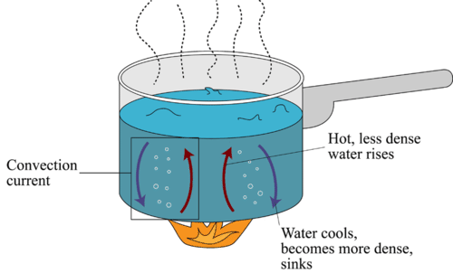
Radiation, Conduction, or Convection

Slide 9
Radiation, Conduction, or Convection

Slide 10
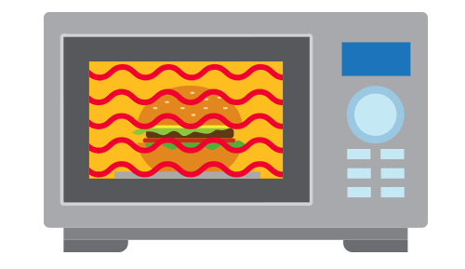
Radiation, Conduction, or Convection

Slide 11
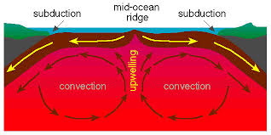
Radiation, Conduction, or Convection

Slide 12
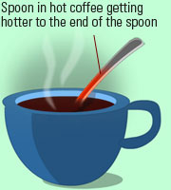
Radiation, Conduction, or Convection

Slide 13
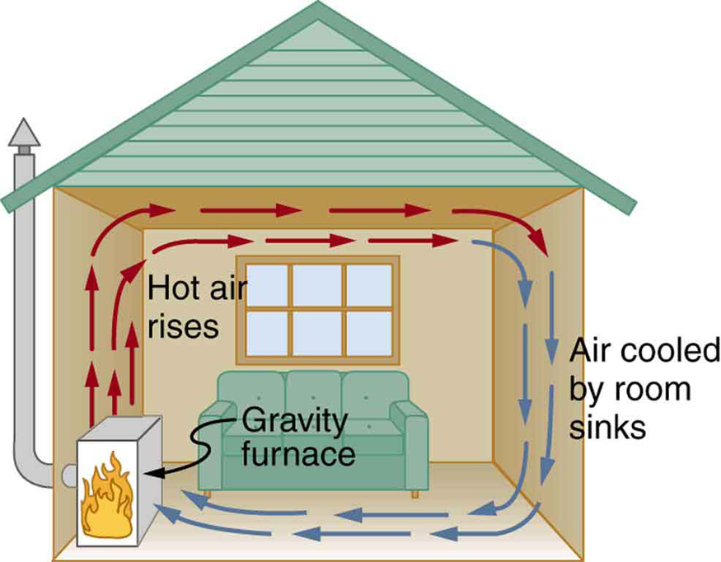
Radiation, Conduction, or Convection

Slide 14
In your own words, DEFINE conduction

Slide 15
In your own words, DEFINE radiation

Slide 16
In your own words, DEFINE convection

Slide 17
BONUS: What is the red liquid that was once in thermometers
Hint, it’s the only metal that is liquid at room temperature

