Slide 1
Forms of Energy
Guided Notes

Slide 2
Learning Targets
I can Find an object’s _________________ ___________________
I can identify the other ______________ _____ __________________
Mechanical
Energy
Forms
Of
Energy

Slide 3
I. How Can I Find an Object’s Mechanical Energy?
All falling basketball, a moving car, & a trophy on a shelf, all have ___________________________ energy.
Mechanical Energy- the form of energy associated with the _________________, _____________________, or ___________________ of an object.
Mechanical
Motion
Position
Shape

Slide 4
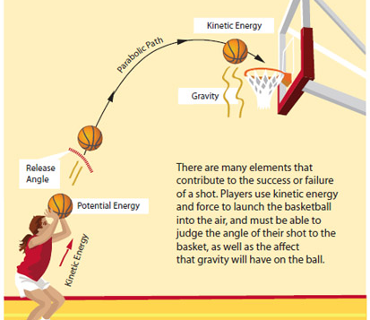
II. Calculating Mechanical Energy
Mechanical energy is the combination of _____________________ energy & _____________________ energy.
The basket ball below has both types of ___________________
The higher basketball moves, the ____________________ the __________________________ energy.
The _______________________ the ball moves the greater the ______________________________ energy.
________________________ energy = Potential energy + kinetic energy
Sometimes an object’s mechanical energy is kinetic energy or potential energy ___________________.
Potential
Kinetic
Energy
Greater
Potential
Faster
Kinetic
Mechanical
ONLY!

Slide 5
Potential energy = 20 J
Kinetic Energy = 2 J
Mechanical energy = ______________
Potential energy = 12 J
Kinetic energy = 10 J
Mechanical energy = _______________
22 J
22 J!

Slide 6
III. Mechanical Energy & Work
An object with mechanical energy can do ________________ on another object.
The more _______________________ energy an object has, the more _________________ it can do.
Work
Mechanical
Work

Slide 7
IV. What Are Other Forms of Energy?
Energy involves ________________, ___________________, or the ____________________ of an object.
Forms of energy associated with the particles of objects include __________________ energy, ________________ energy, ______________________, ____________________________________ , energy & _______________________ energy.
Motion
Position
Shape
Nuclear
Thermal
Electrical
Electromagnetic
Chemical

Slide 8
V. Nuclear Energy
All objects are made of particles are called __________________.
The region in the center of the atom is called the _____________________
Nuclear Energy- is ___________________ energy in the nucleus of the atom.
Energy is released during a ___________________ ____________________
Energy is released when the nucleus _______________
Also called ____________________
When nuclei combine to create energy, it is called ____________________
The _______________ is an example of nuclear fusion
The sun produces ______________ & ________________
What is nuclear energy converted to? _________________________
Give an example of nuclear fission: ____________________________
Atoms
Nucleus
Stored
Nuclear
Reaction
Splits
Fission
Fusion
Sun
Heat
Light
Electricity
Nuclear Bomb / Power Plant

Slide 9
VI. Thermal Energy
Particles that make up objects are constantly in ___________________________
This means they have ________________________ energy
The particle arrangement also gives objects ______________________ energy
The total energy of all the particles of an object is called _____________________________ energy
The _______________________ the temperature, the more _____________________________ _______________________
Faster particle movement = greater ________________________ energy & a higher ________________________________
Which is hotter: a pot of water at 75ºC or a pot of water at 25ºC? _____________
Motion
Kinetic
Potential
Thermal
Higher
Thermal
Energy
Kinetic
Temperature
75ºC

Slide 10
VII. Electrical Energy
The energy of electric charges is ________________________ _________________
Electrical energy can be _____________________ or ___________________
Kinetic electrical energy is ________________________
Example of moving electrical energy: _________________________
Potential electrical energy is ________________________
Example of stored electrical energy: ___________________________
Electrical
Energy
Kinetic
Potential
Moving
Lightning
Stored
Battery

Slide 11
VIII. Electromagnetic Energy
The energy of electric charges
Electromagnetic Energy is ______________________________________________
_____________________________________________________________________
The source of these _________________________ is vibrating electrical charges
An examples of electromagnetic energy include: ________________________, ___-___________, __________-_____________ rays, Infrared or _____________ waves, and ___________________.
Cell phones send and receive messages using ____________________
waves
Electricity
X
Rays
Ultra-violet
Heat
Microwaves
Microwaves

Slide 12
IX. Chemical Energy
Food
Chemical energy is in the _________________ you eat.
Chemical energy is in the ____________________ you use to light a candle
Chemical energy in the cells of your ________________________
Chemical Energy- is ___________________ energy stored in ___________________ _________________.
When the bonds are _______________________, energy is _____________________
Baking soda & _______________________ are good examples.
Match
Body
Potential
Chemical
Bonds
Broken
Released
Vinegar

