Slide 1
Energy

Slide 2
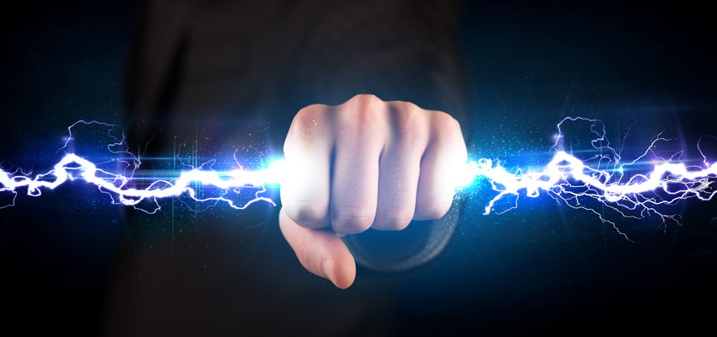
I Can…
Define energy
Identify the 2 main types of energy

Slide 3
Let’s think
Did you put a book in your book bag this morning?
If so, then you did work on your book
Work is done when a force moves an object

Slide 4
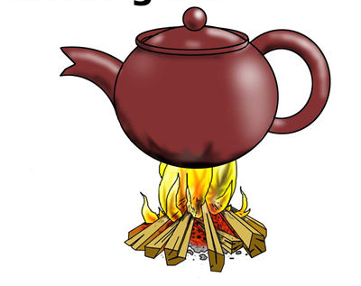
ENERGY
Force
Movement
Work
The ability to do work or cause change

Slide 5
Work & Energy
Work is the transfer of energy
When energy is transferred, 1 object gains energy
One object loses energy
Energy is measured in Joules
It is the SI unit for energy

Slide 6
Power & Energy
POWER is the rate at which work is done
SINCE THE TRANSFER OF ENERGY IS WORK, POWER IS THE RATE AT WHICH ENERGY IS TRANSFERRED
Or the amount of energy transferred in a unit of time
Power = Energy Transferred / Time
Consider…which has more power
A bike or a car
A shovel or a snowblower

Slide 7
2 Types of Energy
Kinetic Energy
2. Potential Energy

Slide 8
Kinetic Energy
Speed
Movement
Work
The energy an object has due to its motion

Slide 9
Kinetic Energy
Kinetic energy depends on the objects mass & speed
Consider this….
Getting hit with a tennis ball that was lightly tossed versus getting hit with a tennis ball moving at high speed.
Which would hurt more?
The fast ball b/c it has more energy
Kinetic energy increases as speed increases
Kinetic energy also increases as mass increases
Consider this…
Suppose a tennis ball is rolling across the floor and hits your foot.
Now think of a bowling ball rolling across the floor & hits your foot
Which would hurt more?
The bowling ball because it has more mass therefore more energy

Slide 10
Calculating Kinetic Energy
KINETIC ENERGY = ½ x Mass x Speed²
A boy is pulling a 10-kg wagon at a speed of 2 m/s²
Fill in given numbers and units
KE = ½ x 10 x 2
Solve for the unknown
2x10 = 20
20 x ½ = 10
10 Joules
Note that changing the mass or the speed will change the kinetic energy
Increasing the mass or speed increases the kinetic energy

Slide 11
Potential Energy
An object that doesn’t have motion can still have energy
Energy can be stored or held in readiness

Slide 12
Potential Energy
Gravity
Elastic
Chemical
The energy that results from the position or shape of an object

Slide 13
3 Types of Potential Energy
Gravitational PE- potential energy related to an objects height
- Weight x Height = GPE
Elastic PE- potential energy associated with its ability to stretch & compress
- The more the object changes shape the greater the energy
Chemical PE- potential energy associated with a substances stored energy
- Reactions with another substance release stored energy

